Slide 1

Carroll County ProjectDox Implementation
Effective January 20, 2026, the Permits and Inspections Department will implement ProjectDox, a cloud-based platform designed to streamline the plan review process for solar panel permits. ProjectDox will integrate with Accela to enhance efficiency and improve coordination throughout the permitting workflow.
Instructions for using ProjectDox will be distributed via a mass email to solar panel contractors and will also be posted on the Accela Citizen Access Portal at https://cppl.carrollcountymd.gov.

Slide 2
What is Project Dox
Cloud based Information Technology Solution from Avolve.
Manages workflows for submission, review, response, and approval of Solar Panel Plans.
Allows for electronic document review for increased efficiency.
Supports Acella Workflows.
Plan submittals for Building Review.

Slide 3
Projectdox Benefits
  Available 24/7/365
  Reduce printing costs
  Save time and travel by submitting and receiving updates online
  Online information access & performance tracking
  Simple and Secure Login/Dashboard
  Help Videos
  Easy Status Look-up
  Centralized communication
    View and Respond to Review Comments Online
    View and Respond to Review Comments via Excel

Slide 4
Permit TYPES USING projectdox
Residential Solar Panels
Plans Managed in Accela Workflow
by Permit Technicians

Slide 5

ProjectDox Supports Acella Workflows for Solar Plan submittals
Prior to using ProjectDox, you must create an Accela Public User Portal account at:
🔗 Carroll County Permitting Portal
This account enables you to:
Submit permit applications online
Upload required documents and plans related to your permit
Once the permit is filed in the Accela portal and plans are uploaded, a Permit Technician will verify all requirements are met for processing.

Slide 6

Plan Submission Requirements
Plan sets
  Full Set of PDFs to scale

Slide 7
PERMIT APPLICATION AND PLAN REVIEW PROCESS
Submit Application & Upload Documents
Visit the Accela Citizen Access Portal: Carroll County Permitting Portal
Follow the on-screen instructions to file your permit application and upload all required plans and documents.
Application Review
A Permit Processor will review and process your application.
Plan Submission to ProjectDox
Once processed, your plans will be electronically transferred to ProjectDox for review.
Plan Review by Examiners
Plan Examiners will review your submitted documents in ProjectDox.
Applicant Notifications & Responses
You will receive email notifications from ProjectDox with links to respond to reviewer comments.
Follow the link provided to access ProjectDox and respond to comments.
Submitting Revisions (if required)
Log in to the Accela Portal.
Select the permit to be revised → click Record Info → go to Attachments to upload revised documents.
Using ProjectDox
When entering ProjectDox, click the "Watch Video" link for task-specific instructions.
Review comments and respond using the Review Comment Interface:
Sign and comply
Respond item-by-item
Upload revised plans (if required)
Final Approval
Once approved, plans will be stamped and made available in the Accela Portal upon permit issuance. Permit and Plans must be printed and made available on site for all inspections.

Slide 8
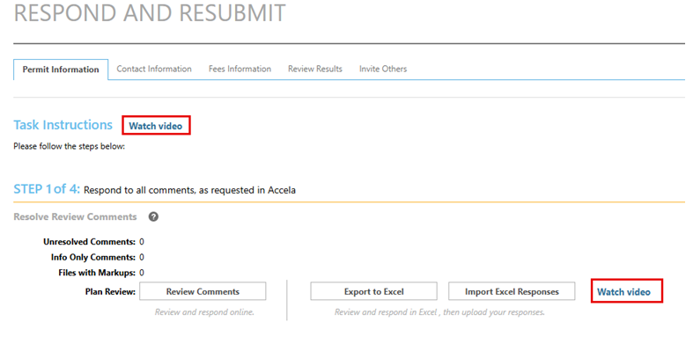
Watch video: The applicant task EMAILs have Watch Video links embedded That are specific to the current task being reviewed. I.E., Review Comments.

Slide 9
If Revised plans are required, FOLLOW STEPS FOR Submission:
Log into Accela Portal
  County Permitting Portal
Open the related permit
Click on Record Detail
Click on Attachments
Upload revised plans and include “Revised Plans,” Permit Number, and Date in the document name
Upload revised plans
Full Set of PDFs to scale

Slide 10

Respond and Resubmit
THE FOLLOWING SLIDE IS FOR RESPONDING TO COMMENTS ONLY.
IF REVISED PLANS ARE REQUIRED, THEY MUST BE SUBMITTED VIA THE ACCELA PORTAL AT:
https://cppl.carrollcountymd.gov
.

Slide 11
Respond and Resubmit

Slide 12
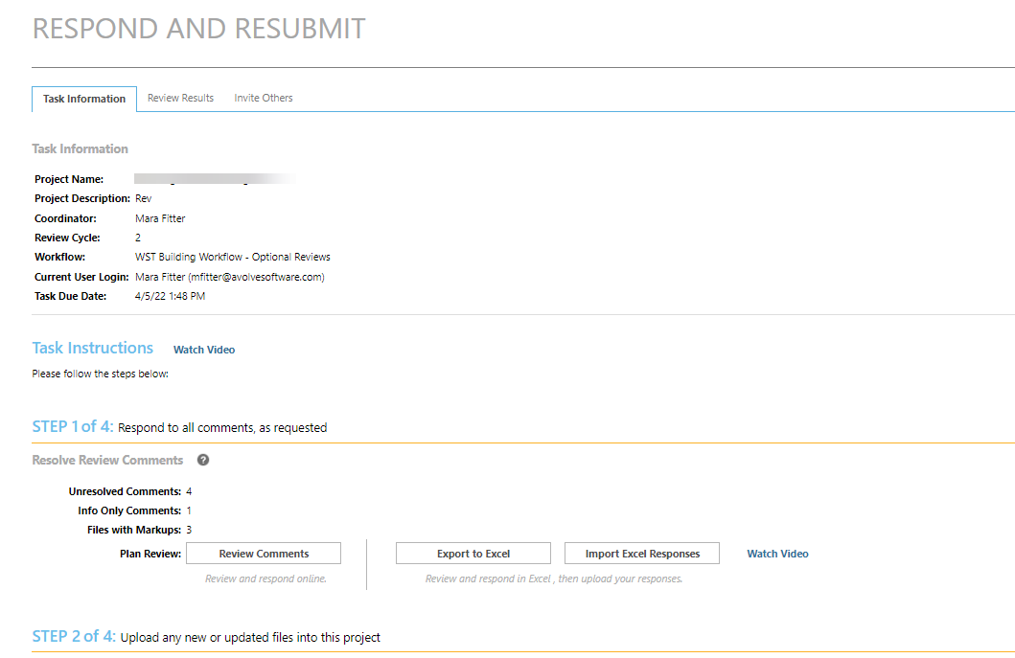
Respond and Resubmit - eForm
Follow the steps:

Slide 13
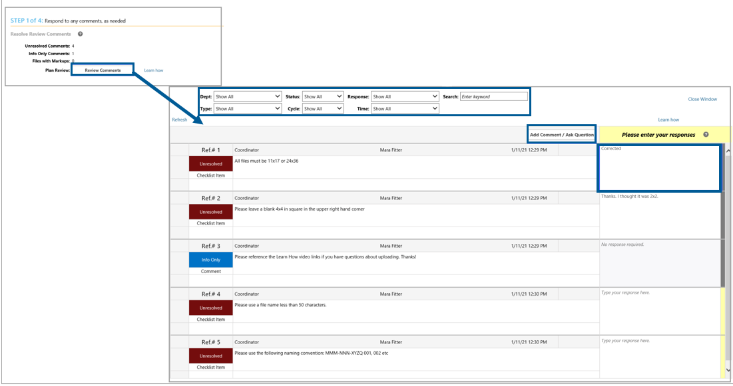
Applicant – Review Comments

Slide 14
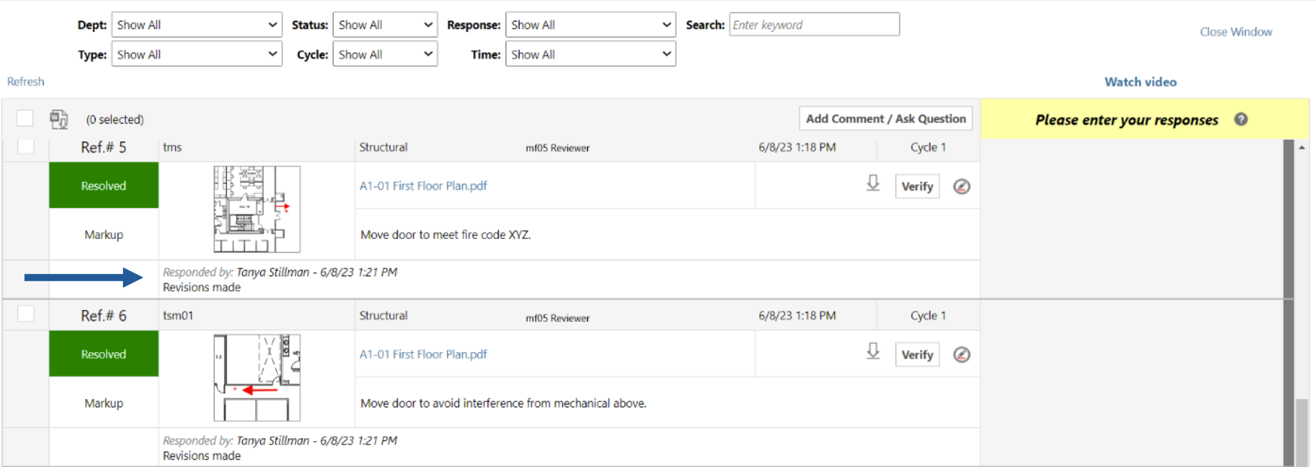
Review Comments Grid

Slide 15
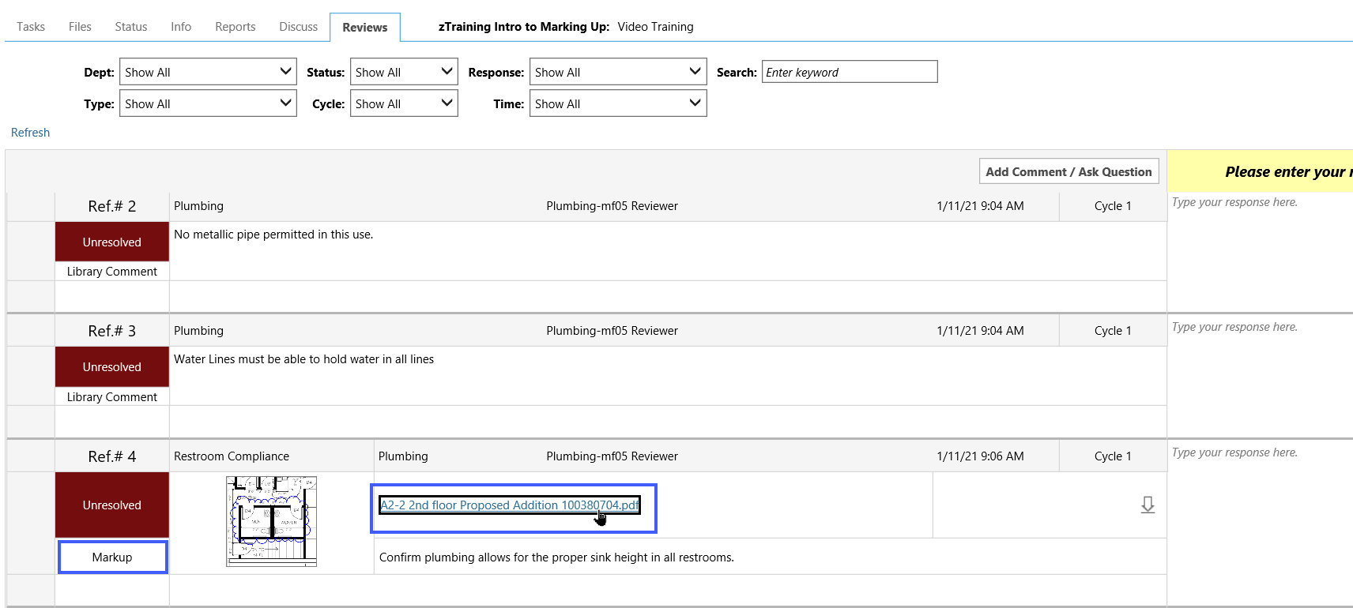
Applicant – Review Comments

Slide 16
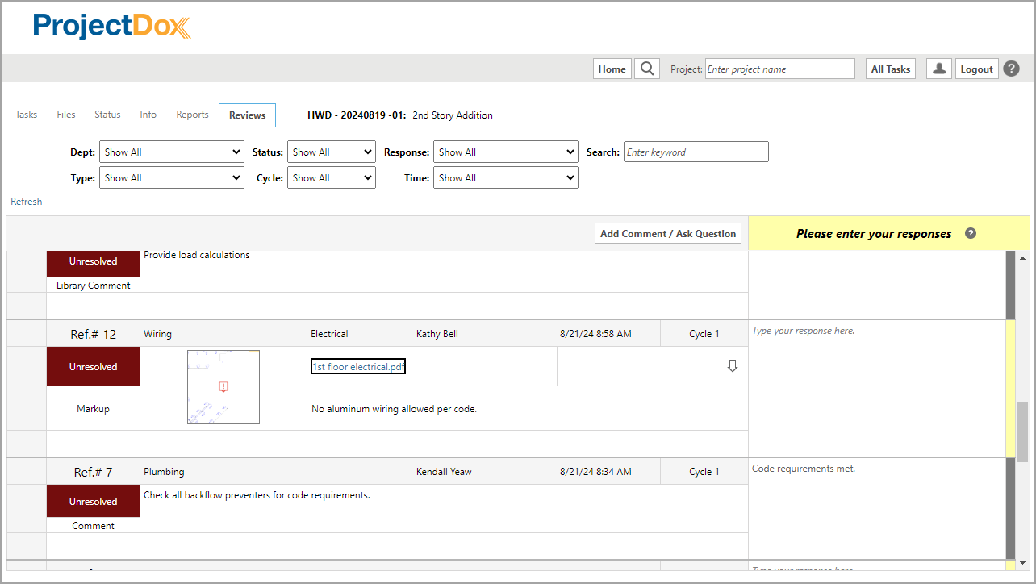
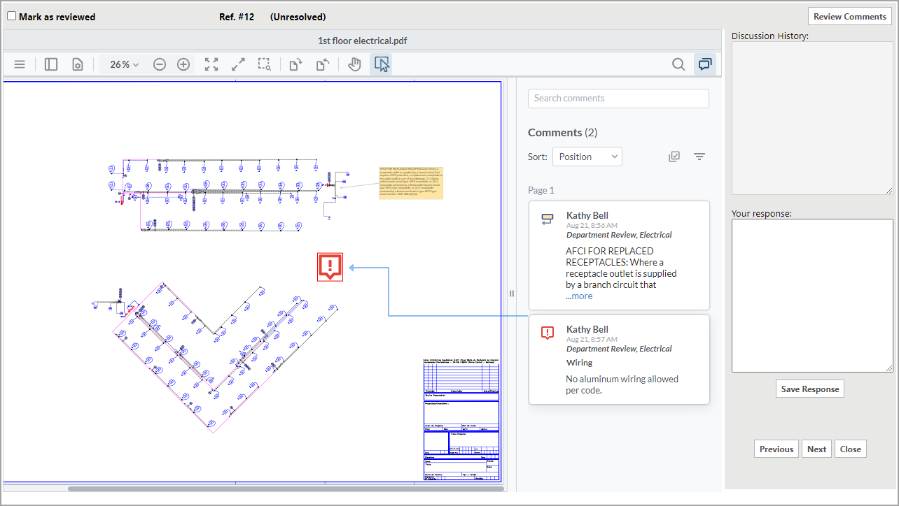
Applicant – Review Comments

Slide 17
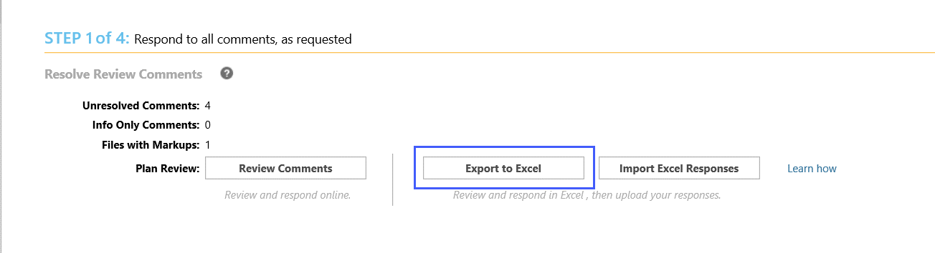
Applicant – Export/Import Review Comments - Excel

Slide 18
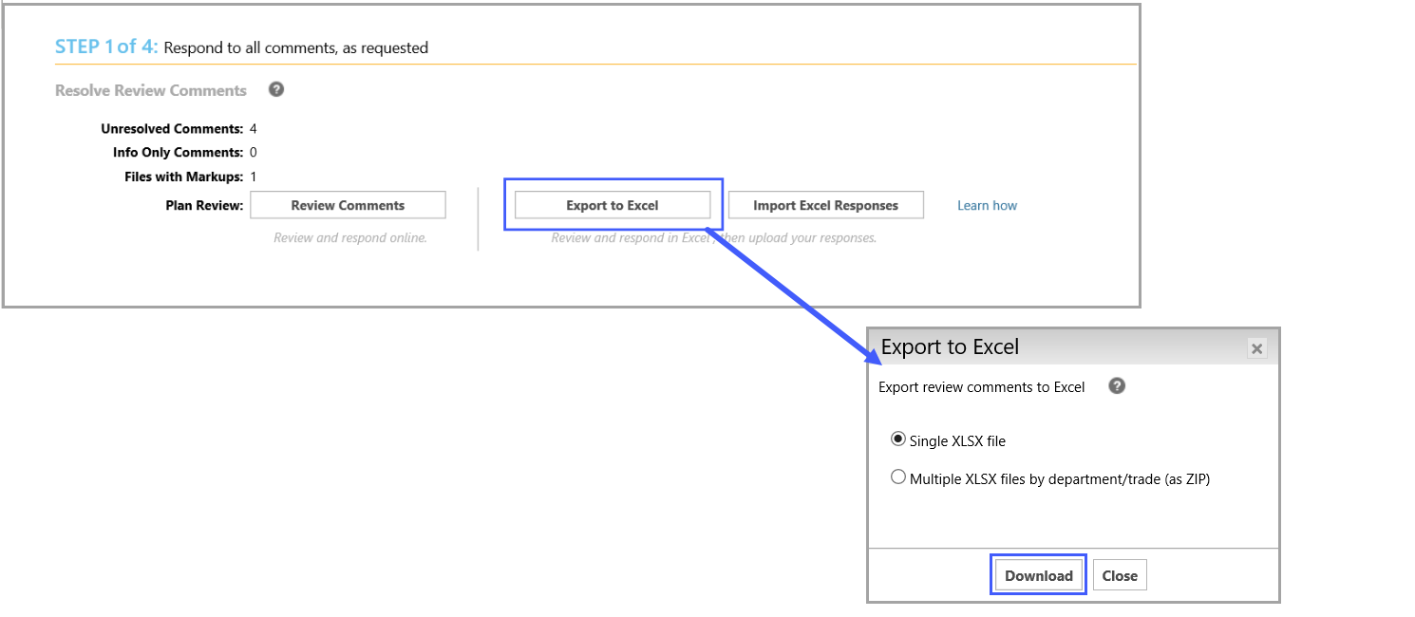
Applicant – Export/Import Review Comments

Slide 19
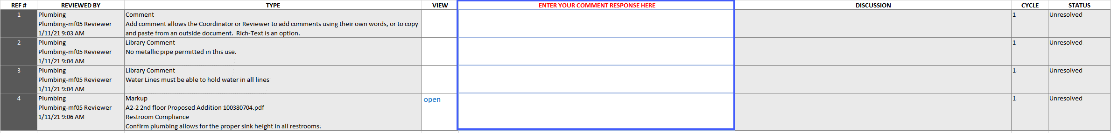
Applicant – Export/Import Review Comments

Slide 20
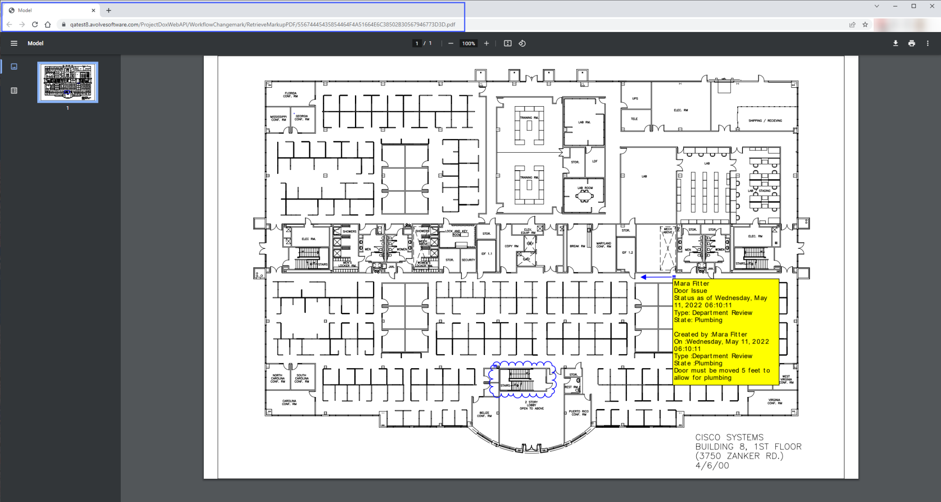
Applicant – Export/Import Review Comments

Slide 21
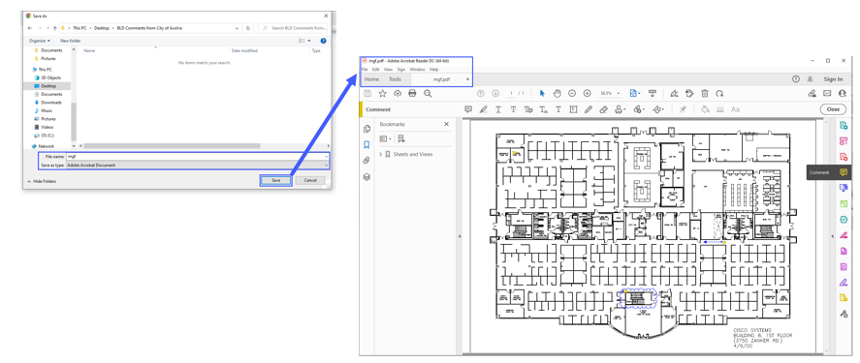
Applicant – Export/Import Review Comments

Slide 22
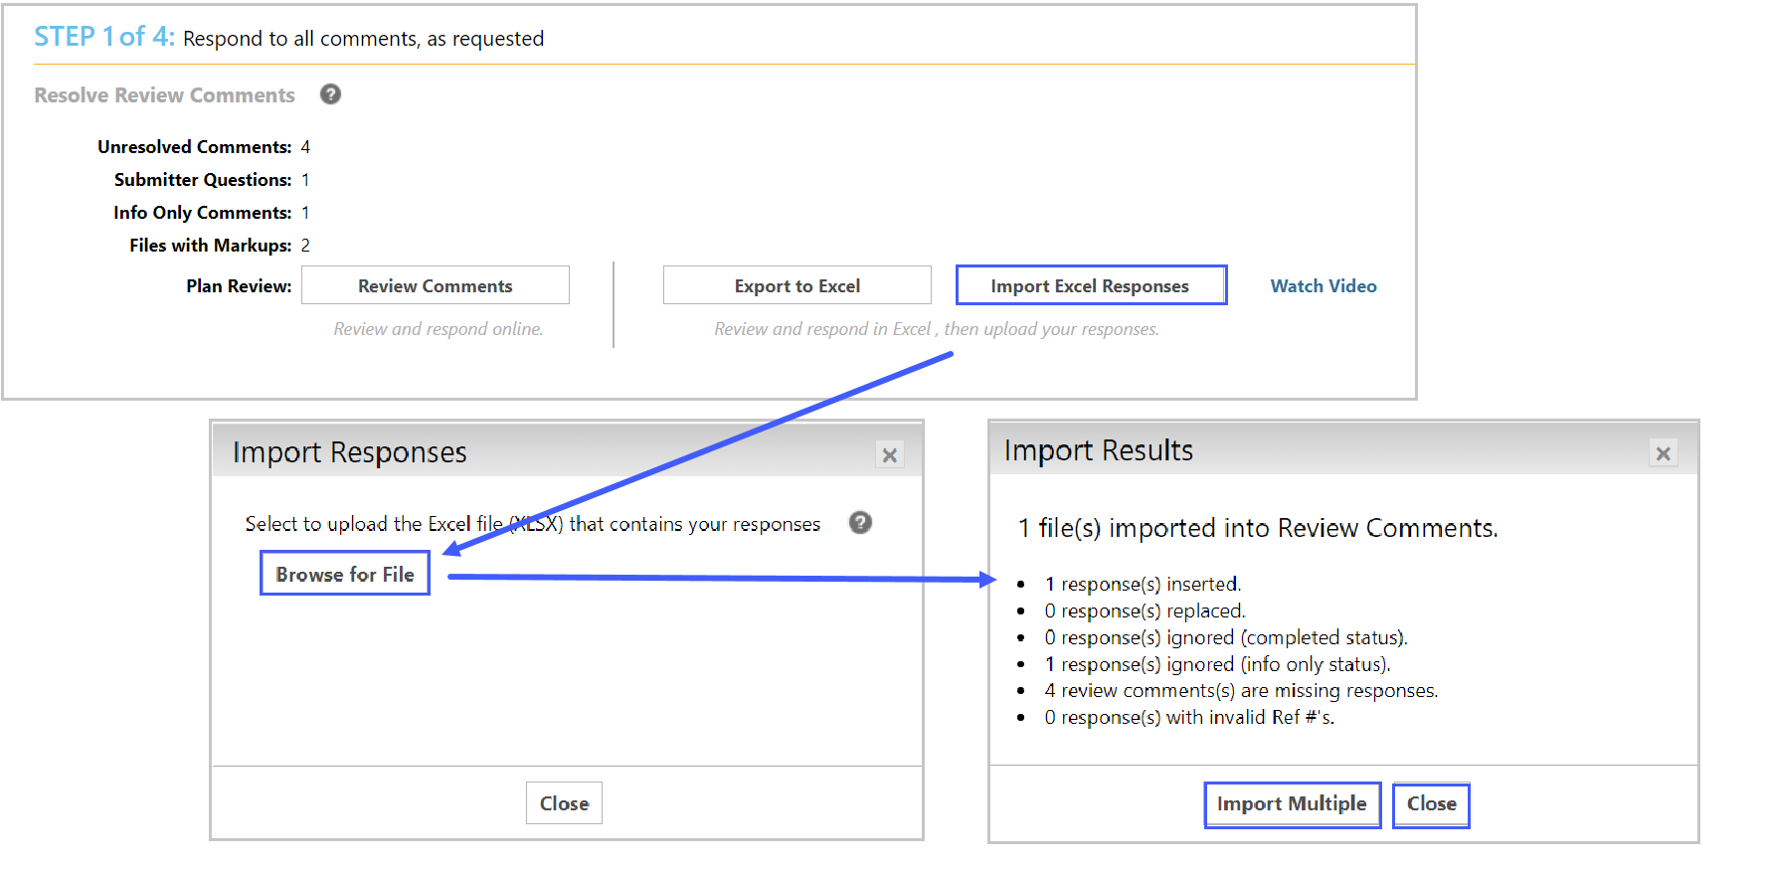
Applicant – Export/Import Review Comments

Slide 23
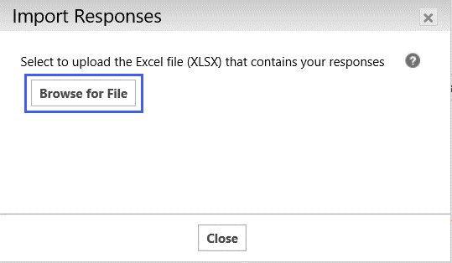
Applicant – Export/Import Review Comments

Slide 24


Plans are approved and stamped AND SENT TO
Accela portal http://cppl.carrollcountymd.gov upon issuance of building permit
Contractor must print approved stamped plans and issued building permit and have available on site prior to 1st inspection
*Missed inspection fee may apply if stamped approved plans are not on site

